Slide 1
Welcome to London
Презентацию подготовила:
Рогулина Т. М.
Учитель английского яз.
ГБОУ №292 г. С- Петербурга

Slide 2
The United Kingdom of Great Britain
The United Kingdom of Great Britain and Northern Ireland consists of 4 parts:
England
Scotland
Wales
Northern Ireland

Slide 3
National Flag of the UK
The flag of UK is known as “The Union Jack”.
This red, white and blue flag was first used in 1801.
The flag of the UK is a combination of the flags of England, Scotland, and Ireland.

Slide 4
The Queen of the UK
Elizabeth II is the Queen of England.
The Queen is the Head of State, though in fact she has no real power.

Slide 5
London and its Sights
London is the capital city of England and the UK with a population above 6-7 million people.
It stands on the river Thames and was founded by the Romans.
It’s one of the world’s most important commercial and cultural centers.

Slide 6
Buckingham Palace
Buckingham Palace is the official residence of the Queen of England.
When the Queen is here the royal standard flutters over the palace.
The ceremony changing the guard takes place in front of the palace daily from April to August.

Slide 7
Tower Bridge
London’s Tower Bridge is one of the most recognizable bridges in the world.
It is constructed in Victorian Gothic style to be in a harmony with nearby Tower of London

Slide 8
The Tower
The Tower of London was used as a fortress, a royal residence, a prison and the king’s Zoo.
Now it is a museum of amour.
The Crown Jewels and famous ravens attract tourists every year.

Slide 9
Westminster Abbey
Westminster Abbey is more a historical site than a religious site.
All English kings have been crowned and buried in this church since 1308. It’s well known for its Poets’ Corner with memorials to English poets and writers.

Slide 10
The Houses of Parliament
The Houses of Parliament is the seat of the two parliamentary houses of the UK: the House of Lords and the House of Commons .
The most famous feature is its clock tower, known as Big Ben.

Slide 11
Big Ben
The large clock in one of the towers is Big Ben.
You can hear the sound of Big Ben every hour in London.
The clock and the bell got their names after Sir Benjamin Hall.
He was a tall man and his nickname was Big Ben.

Slide 12
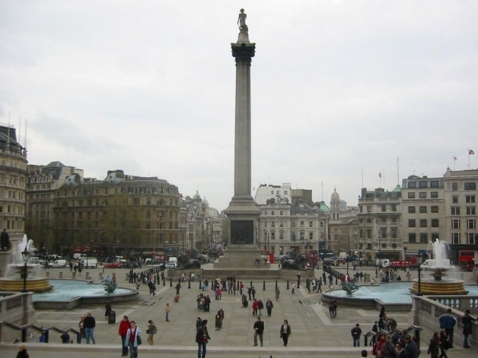
Trafalgar Square
Trafalgar square is the heart of the city.
In the middle of the square stands a tall column honoring admiral Nelson.
Four Bronze lions look at the square from the monument.
There are two beautiful fountains in the square.

Slide 13
Christmas Tree
Every winter there is a big Christmas tree which is a gift from Norway in the middle of the square.
On the New Year’s Eve people gather around the tree.

Slide 14
Madam Tussaud’s Museum
The museum was founded by wax sculptor Marie Tussaud in 1835.
There are wax figures of actors, singers, scientists, politicians.
The museum has its branches in many countries of the world.

Slide 15
St. Paul’s Cathedral
It’s the largest Protestant Church in England.
The cathedral was designed by court architect Sir Christofer Wren.
It contains the unique Whispering Gallery where you can hear the whisper of the person standing at the other end of the gallery.

Slide 16
London Eye
It’s both for sightseeing and amusement.
It’s a giant observation wheel in the centre of London.
It offers visitors the 30-minutes ride to reveal panoramic views over the city.
The wheel comprises 32 capsules each with capacity of 25 people.

Slide 17
Thank you for your attention

